Slide 1
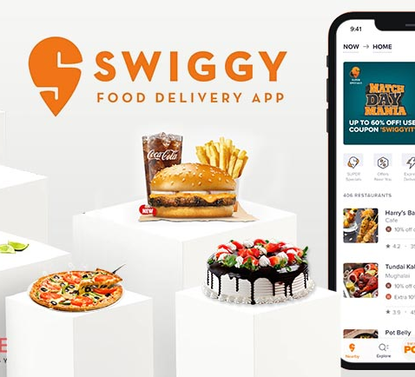
SWIGGY ANALYSIS
RM SREE SAVITHA
BADM-WD-T-B5

Slide 2

COMPANY OVERVIEW
COMPANY INFORMATION
Company Name | Swiggy
Legal Name | Bundl Technologies Private Ltd
Incorporation | 2014
Head Office | Bangalore, Karnataka, India
Industry Type | Online Food Ordering
Founder & CEO | SriHarsha Majety
Website | https://www.swiggy.com/
Company Type | Private
Business Model | B2C, B2B
Revenue (In Crores) | Rs.11,247 Crores by Q2FY24
Employees | 6000+
Total Funding IPO in 2024 | US$ 3.62 Billion in 16 Rounds
Services | Food Delivery, Online Grocery, Courier, & more
Market Capital | 1.21 Trillion INR
Top Investors | 65 institutional investors include Bessemer Venture Partners, SAIF Partners, Accel, Norwest Venture Partners, DST Global, Prosus & more,.

Slide 3
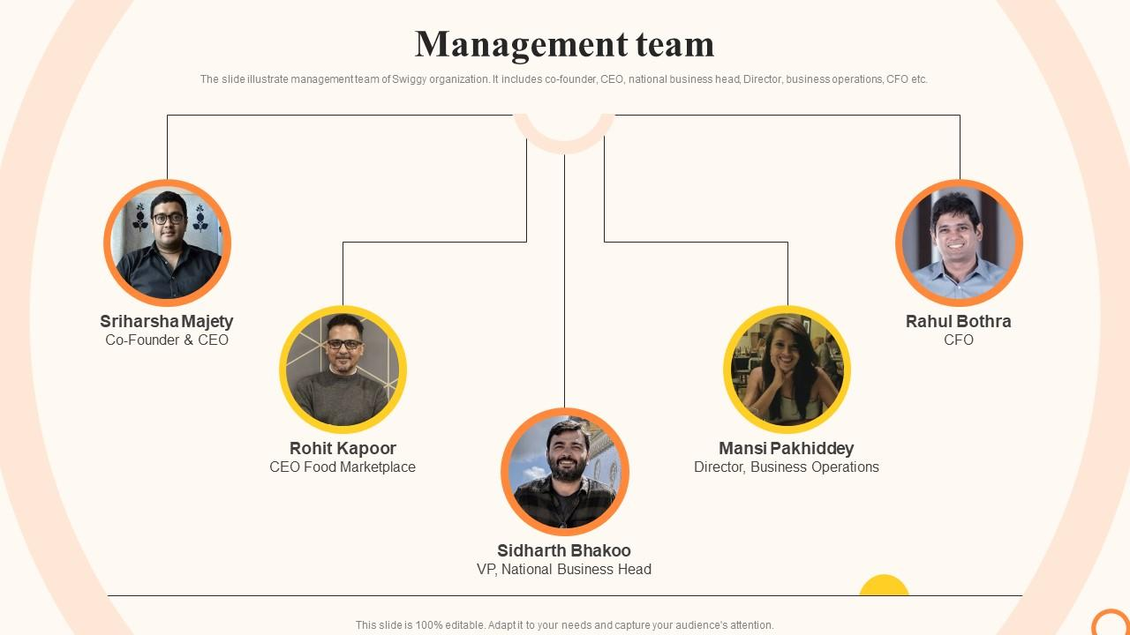
MISSION “ Change the way India Eats ”
VISION
“ Our mission is to elevate the quality of life for the urban consumer with unparalleled convenience. Convenience is what makes us tick. It's what makes us get out of bed and say, "Let's do this "

Slide 4
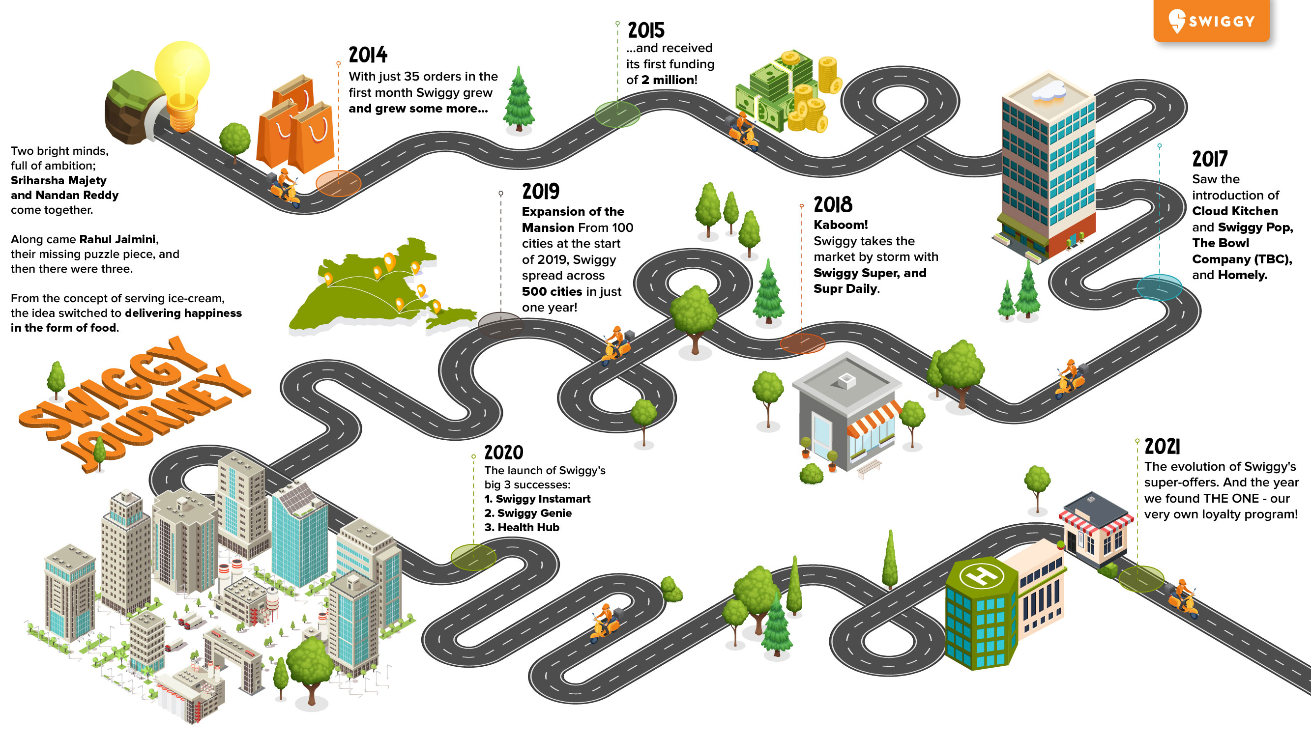




The Swiggy JOURNEY
2014 - Launch of our Food Delivery Business. 2020 - Launch of Swiggy Instamart and Swiggy Genie. 2021 - Launch of Membership programme Swiggy One. 2022 - Acquisition and Integration of Dineout and Swiggy app. 2022 - Launch of Swiggy Minis. 2023 - Launch of Swiggy HDFC Bank co-branded credit card. 2024 - The Swiggy platform crossed 110 million ever-transacted users.

Slide 5



SERVICES OFFERED
1
2
3
4
5
FOOD DELIVERY
Restaurant Aggregation
Customizable Orders
Scheduled Delivery
INSTAMART
Grocery Delivery
Express Delivery
SWIGGY ONE
1. Subscription Plans
SWIGGY ACCESS
1. Cloud Kitchen Services
SWIGGY GENIE
1. Personalized Pickup & Drop Services
6
7
8
9
10
CORPORATE SERVICES
1. Swiggy Corporate
SWIGGY DAILY
1. Home–style food
HEALTH & NUTRITIONAL OFFERINGS
1. Calorie-Friendly Meals
2. Nutritional Information
DINING OUT
1. Dineout Integration
PREMIUM & EXCLUSIVE RESTAURANTS
1. Partnership with Premium restaurants
3 Billion+ Orders Delivered | 220k+ Restaurant Partners
EVENT-BASED OFFERINGS
1. Offers during Festivals, Sports & Local Celebrations
520k+ Delivery Partners | 680+ Cities in India
11
No Minimum Order
Order in for yourself or the group, with no restrictions on order value.
Live Order Tracking
Know where your order is always, from the restaurant to your doorstep.
Lightning-Fast Delivery
Experience Swiggy's superfast delivery for food delivered fresh & on time.
10

Slide 6
Business Model Canva
Model Canvas of The Swiggy
Key Partners
Key Activities
Value Propositions
Customer Segments
Partnership with Restaurants
Hiring Delivery Partners
Managing payment process
No Minimum Order Quality requirement
Variety of payment options
No Restriction order policy
People who want products to be delivered at the doorstep
People who wanted to order food online.
People who do not wish to go to restaurants
Restaurants
Shops
Groceries
Delivery Partners
Customer Relationship
Channels
Key Resources
24*7 Customer service
Chat support service
Social media Handle
Mobile App
Website
Social Media
Local restaurants, Shops
Delivery Providers
Technology
Payroll expenditure for employees
and delivery partners
Website development cost
Maintenance and running cost
Advertisement and Marketing expenditure
Delivery charge 30 – 35%
Commission model
Restaurant advertisements
Swiggy super
Cost Structures
Revenue Streams

Slide 7
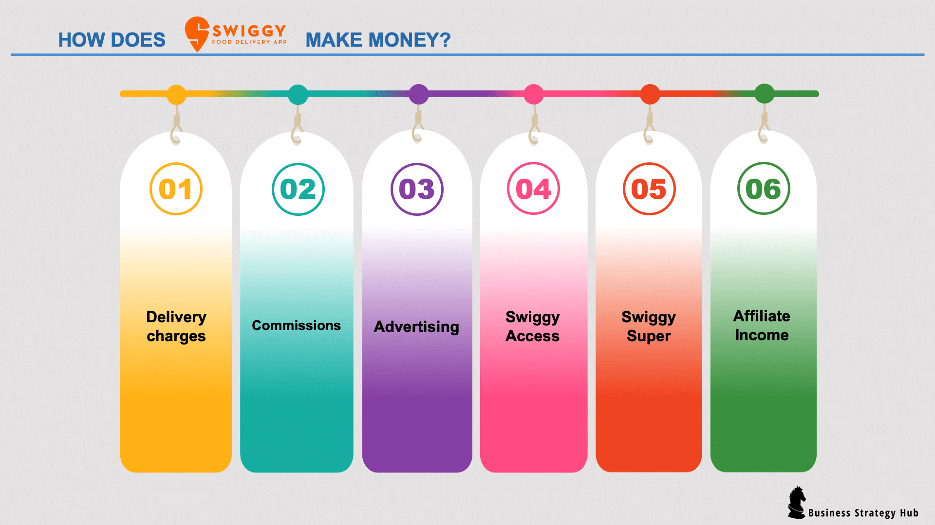
REVENUE MODEL
6 MAIN REVENUE STREAMS OF SWIGGY
Swiggy Instamart
Event-Based Earnings
Swiggy Genie
OTHER STREAMS OF REVENUE
Swiggy Dineout
Corporate Services
Data Monetization
Swiggy One
Cancellation & Convenience fees

Slide 8










SWIGGY OPERATING AREAS
Swiggy operates in over 580+ cities across India Including Major Cities like,
BANGALORE
CHENNAI
JAIPUR
LUCKNOW
BOLT: FOOD DELIVERY including Emerging Hubs and Tier-2 & Tier-3 cities.
INSTAMART: Operates in 43 cities.
GOURMENT: Premium food delivery service available in 31 cities.
DELHI
HYDERABAD
PUNE
MUMBAI
COIMBATORE
AHMEDABAD

Slide 9

RESTAURANT ANALYSIS OF SWIGGY

Slide 10
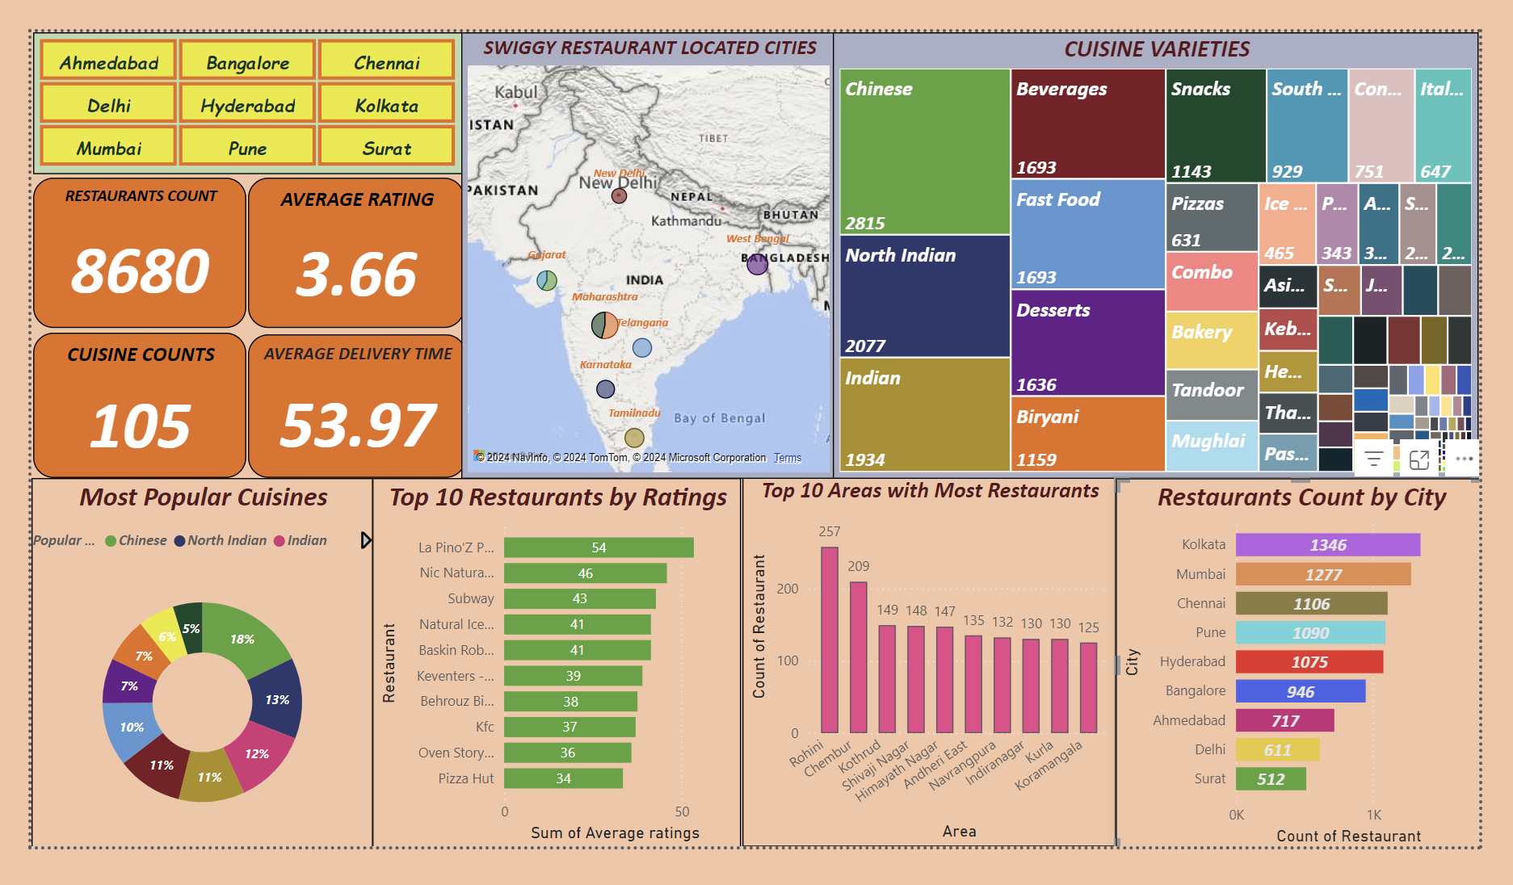
POWER BI DASHBOARD OF SWIGGY RESTAURANT ANALYSIS

Slide 11
TASK 1: TOP 10 AREAS WITH MOST RESTAURANTS
Objective: Identify the top 10 areas with the highest number of restaurants.
Restaurant Areas | City | Count of Restaurant
Rohini | Delhi | 257
Chembur | Mumbai | 208
Kothrud | Pune | 149
Andheri East | Mumbai | 135
Navrangpura | Ahmedabad | 132
Indiranagar | Bangalore | 130
Kurla | Mumbai | 129
Koramangala | Bangalore | 124
Bidhannagar | Kolkata | 123
Ashok Nagar | Bangalore | 113
Key Insight:
Rohini has the highest number of restaurants (257), followed by Chembur (208).
Other areas like Kothrud, Andheri East, and Navrangpura have significantly fewer restaurants, with counts ranging between 149 and 113.
This highlights key hotspots for restaurant density.

Slide 12
TASK 2: MOST POPULAR FOOD TYPES SERVED IN EACH CITY
Objective: Determining the most popular food types served in each city.
City | Cuisine | Serving Restaurants Count
Ahmedabad | Indian | 206
Bangalore | Desserts | 273
Chennai | Chinese | 313
Delhi | Chinese | 224
Hyderabad | Chinese | 308
Kolkata | Chinese | 541
Mumbai | Chinese | 503
Pune | Chinese | 336
Surat | Fast Food | 158
Key Insights:
Mumbai Chinese dominates with the highest count (541), followed by Kolkata Chinese (503).
Other notable food types include Pune Chinese (336) and Chennai Chinese (313).
Ahmedabad Indian and Surat Fast Food have the lowest counts (206 and 158 respectively).
This chart highlights regional preferences for specific cuisines.

Slide 13
TASK 3: TOP-RATED SWIGGY RESTAURANTS IN PERCENTAGE
Objective: To find the Percentage of Top-Rated Restaurants.
Restaurants by Rating | Total Count | Percentage %
Top Rated | 324 | 3.73%
Non-Top Rated | 8356 | 96.27%
Total Restaurants | 8680 | 100%
Key Insights:
Non-top-rated restaurants constitute the majority, accounting for 96.27%.
Top-rated restaurants make up only 3.73%.
This highlights a significant disparity, indicating a limited representation of highly-rated restaurants among the total.

Slide 14

TASK 4: CORRELATION FACTORS AFFECTING AVERAGE RATING
Objective: To Identify correlations between different factors.
CORRELATION MATRIX TABLE
Restaurant Data | Price | Total ratings | Delivery time | Average ratings
Price | 1
Total ratings | -0.01 | 1
Delivery time | 0.08 | -0.08 | 1
Average ratings | 0.11 | 0.16 | -0.15 | 1

Slide 15

TASK 4: CORRELATION FACTORS AFFECTING AVERAGE RATING
Matrix Explanation:
Key Insights:
Price and Avg Ratings (0.113): Weak positive relationship; higher prices might slightly improve ratings.
Delivery Time and Avg Ratings (-0.147): Faster deliveries slightly improve customer satisfaction.
Total Ratings and Avg Ratings (0.158): More ratings are slightly associated with higher average ratings.
Price vs. Total ratings (-0.0147):
There is a very weak negative correlation. This means that price changes have almost no impact on the total ratings.
Total ratings vs. Delivery time (-0.084):
A weak negative correlation. Restaurants with more ratings tend to have slightly faster delivery times.
Price vs. Delivery time (0.076):
A weak positive correlation. Price has a slight tendency to increase with delivery time.
Total ratings vs. Average ratings (0.158):
A weak positive correlation. Restaurants with more ratings tend to have slightly better average ratings.
Price vs. Average ratings (0.114):
A weak positive correlation. Higher prices might be slightly associated with better average ratings.
Delivery time vs. Avg ratings (-0.147):
A weak negative correlation. Faster delivery times might slightly contribute to better average ratings.

Slide 16



TASK 5: CORRELATION B/W PRICE & AVERAGE RATING
Objective: To analyze the relationship between restaurant prices and average ratings.
"The correlation coefficient (r = 0.11) shows a weak positive relationship between restaurant price and average rating. This indicates that higher-priced restaurants may receive slightly better ratings, but the effect is minimal."
Correlation value: r = 0.11
Insight:
Weak positive correlation
"As shown in the scatter plot, there is a weak positive correlation between price and average ratings. However, since the relationship is not strong, price alone is not a significant predictor of ratings."

Slide 17

TASK 6: CITY-wise RESTAURANT COUNT
Objective: To determine the number of restaurants in different areas of each city.
City | Area Count by City-wise | Restaurant Count
Kolkata | 136 | 1346
Mumbai | 68 | 1277
Chennai | 79 | 1106
Pune | 91 | 1090
Hyderabad | 150 | 1075
Bangalore | 77 | 946
Ahmedabad | 81 | 717
Delhi | 81 | 611
Surat | 79 | 512
Total | 842 | 8680
Key Insights:
Kolkata has the highest number of restaurants (1,346), followed by Mumbai (1,277) and Chennai (1,106).
Pune (1,090) and Hyderabad (1,075) also have significant counts.
The cities with comparatively fewer restaurants are Bangalore (946), Ahmedabad (717), Delhi (611), and Surat (512).

Slide 18

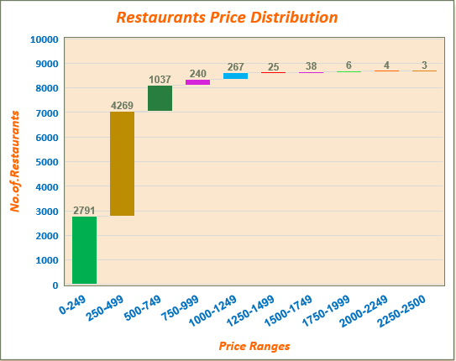
TASK 7: PRICE ANALYSIS
Objective:
To find out the Restaurant Price Distribution Analysis of restaurants.
S.no | Price Range | Sum of Restaurant
A | 0-249 | 2791
B | 250-499 | 4269
C | 500-749 | 1037
D | 750-999 | 240
E | 1000-1249 | 267
F | 1250-1499 | 25
G | 1500-1749 | 38
H | 1750-1999 | 6
I | 2000-2249 | 4
J | 2250-2500 | 3
Grand Total |  | 8680

Slide 19

TASK 7: PRICE ANALYSIS
Key Insights:
Most Common Price Ranges:
The most popular and reasonably priced restaurant categories are those within the ₹250–₹499 range (4,269), followed by ₹0-₹249 (2,791).
Mid-Range Pricing:
Restaurants with prices between ₹500 and ₹749 (1,037) are rather prevalent.
Higher price ranges witness a sharp decline; ₹1000–₹1249 (267) and ₹750–₹999 (240) are less common.
Premium Categories:
Only 25 restaurants fall within the pricing range of ₹1,250–₹1,499, which is the least represented.
The rarity of ultra-premium pricing is demonstrated by the fact that only three restaurants fall into the highest price bracket, which is ₹2250-₹2500.
Trend Insight:
In contrast to the limited luxury options, the chart shows a strong preference for mid-tier and low prices among restaurants catering to budget-conscious consumers.

Slide 20
TASK 8: DELIVERY TIME ANALYSIS
Objective: To Analyse the average delivery time of restaurants.
Delivery time in MINS | Ahmedabad | Bangalore | Chennai | Delhi | Hyderabad | Kolkata | Mumbai | Pune | Surat | Total by Avg Delivery Time
20-40 | 297 | 194 | 113 | 177 | 368 | 40 | 249 | 229 | 153 | 1820
41-60 | 375 | 624 | 486 | 292 | 397 | 361 | 962 | 423 | 275 | 4195
61-80 | 37 | 128 | 463 | 142 | 294 | 677 | 66 | 414 | 82 | 2303
81-120 | 8 | 0 | 44 | 0 | 16 | 268 | 0 | 24 | 2 | 362
Total by Count of Restaurants by City | 717 | 946 | 1106 | 611 | 1075 | 1346 | 1277 | 1090 | 512 | 8680

Slide 21

TASK 8: DELIVERY TIME ANALYSIS
Key Observation
Most restaurants across cities have an average delivery time of 41-60 minutes.
Kolkata leads in the 61-80 minutes range, indicating potential delays compared to other cities.
Minimal restaurants in all cities have delivery times above 81 minutes, showing effective overall delivery management.
City-Specific Insights:
Delhi: Highest number of restaurants delivering in the 41-60 minutes range (962).
Kolkata: Many restaurants (677) fall into the 61-80-minute range, requiring attention to reduce delivery delays.
Other cities, such as Bangalore, Hyderabad, Mumbai, and Pune, show balanced delivery time distributions within the 20-60 minute range.
Actionable Insights:
Focus on improving delivery efficiency in Kolkata to reduce delays.
Benchmark Delhi's 41-60 minute performance and replicate best practices in other cities.
Monitor cities with higher delivery times and explore solutions like optimized routes or additional delivery staff.

Slide 22




TASK 9: CUISINE ANALYSIS
Objective:
To Analyse the variety of cuisines offered by restaurants.
"Swiggy showcases an impressive diversity of nearly 150+ cuisine varieties offered by its partnered restaurants, catering to a wide range of tastes and preferences.“
Afghani | Biryani | German | Jain | Mangalorean | Parsi | Spanish
African | Bowl Company | Goan | Japanese | Mediterranean | Pastas | Steakhouse
American | British | Greek | Juices | Mexican | Persian | Street Food
Andhra | Burmese | Grill | Kashmiri | Middle Eastern | Pizzas | Sushi
Arabian | Cafe | Gujarati | Kebabs | Mongolian | Portuguese | Sweets
Asian | Chaat | Haleem | Kerala | Mughlai | Punjabi | Tandoor
Assamese | Chettinad | Healthy Food | Keto | Naga | Rajasthani | Telangana
Australian | Chinese | Home Food | Keventers & more | Navratri Special | Raw meats | Tex-Mex
Awadhi | Coastal | Hyderabadi | Konkan | Nepalese | Rayalaseema | Thai
Bakery | Combo | Ice Cream | Korean | North Eastern | Salads | Thalis
Bangladeshi | Continental | Ice Cream Cakes | Lebanese | North Indian | Seafood | Tibetan
Barbecue | Desserts | Indian | Lucknowi | Oriental | Sindhi | Tribal
Bengali | European | Indonesian | Maharashtrian | Oriya | Singaporean | Turkish
Beverages | Fast Food | Italian | Malaysian | Paan | Snacks | Vietnamese
Bihari | French | Italian-American | Malwani | Pan-Asian | South Indian | Waffle

Slide 23
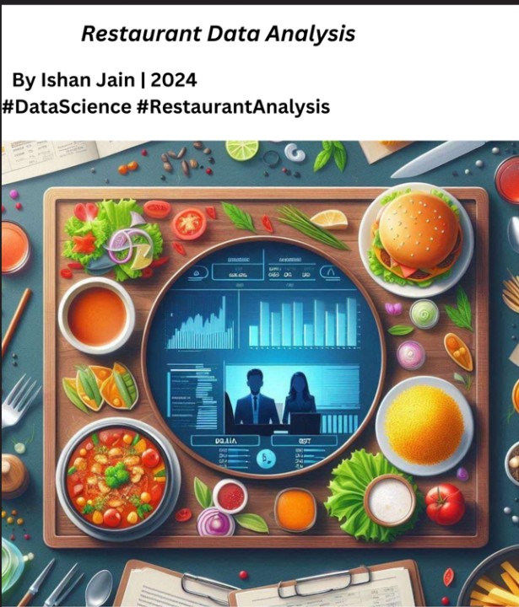
CUISINE ANALYSIS
Most Popular Cuisines | Restaurants Count
Beverages | 1693
Biryani | 1159
Chinese | 2815
Continental | 751
Desserts | 1636
Fast Food | 1693
Indian | 1934
North Indian | 2077
Snacks | 1143
South Indian | 929
Distinctive cuisines | Restaurants Count
Assamese | 1
Bihari | 1
German | 1
Tex-Mex | 1
Navratri Special | 2
Oriya | 2
Raw meats | 2
Spanish | 2
Tribal | 2
Most Popular Cuisines:
Highlights how widely available popular cuisines are by listing the most popular cuisines and the number of restaurants serving them.
Most Popular Cuisines:
Concentrates on uncommon, unique offers and showcases rare and less frequently served cuisines.

Slide 24

RESTAURANT cum CUISINE ANALYSIS
Restaurants by Cuisine type serving | Cuisine Count | Restaurant Count by Cuisines Count
1 Cuisine Restaurant | 1 | 2314
2 Cuisine Restaurant | 2 | 2219
3 Cuisine Restaurant | 3 | 1776
4 Cuisine Restaurant | 4 | 1008
5 Cuisine Restaurant | 5 | 547
6 Cuisine Restaurant | 6 | 321
7 Cuisine Restaurant | 7 | 190
8 Cuisine Restaurant | 8 | 121
9 Cuisine Restaurant | 9 | 54
10 Cuisine Restaurant | 10 | 40
11 Cuisine Restaurant | 11 | 23
12 Cuisine Restaurant | 12 | 21
13 Cuisine Restaurant | 13 | 5
14 Cuisine Restaurant | 14 | 10
15 Cuisine Restaurant | 15 | 2
16 Cuisine Restaurant | 16 | 5
17 Cuisine Restaurant | 17 | 10
18 Cuisine Restaurant | 18 | 7
20 Cuisine Restaurant | 20 | 5
23 Cuisine Restaurant | 23 | 2
Total |  | 8680
Key Insights
This table summarizes the distribution of restaurants based on the number of cuisines they offer, with a total count of 8,680 restaurants.
Distribution of Restaurants by Cuisine Variety
Single-Cuisine Dominance:
Most restaurants (2,314) serve only one type of cuisine.
Multi-Cuisine Restaurants:
The count of restaurants decreases as the number of cuisines offered increases.
Restaurants serving two cuisines total 2,219, while those offering three cuisines total 1,776.
Rarer Offerings:
Restaurants offering 10 or more cuisines are significantly fewer, with counts dropping to as low as 2 restaurants offering 23 cuisines.
Total Overview:
Across all cuisine categories, the combined total of restaurants amounts to 8,680.
Slide Summary Idea: Highlight how restaurant specialization varies, with most establishments focusing on fewer cuisines, catering to specific tastes, while only a small fraction offers extensive variety. Use this to discuss market trends and customer preferences.

Slide 25
FOOD TYPE SERVED BY RESTAURANTS
The number of Swiggy restaurants serving each style of cuisine is broken out in this table.
S.no | Cuisine Varieties | Restaurant Count by each cuisine | S.no | Cuisine Varieties | Restaurant Count by each cuisine | S.no | Cuisine Varieties | Restaurant Count by each cuisine | S.no | Cuisine Varieties | Restaurant Count by each cuisine | S.no | Cuisine Varieties | Restaurant Count by each cuisine
1 | Chinese | 2815 | 22 | Asian | 254 | 43 | Andhra | 69 | 64 | French | 14 | 85 | Sindhi | 6
2 | North Indian | 2077 | 23 | Kebabs | 250 | 44 | European | 69 | 65 | Awadhi | 13 | 86 | Bangladeshi | 5
3 | Indian | 1934 | 24 | Healthy Food | 245 | 45 | Cafe | 58 | 66 | Coastal | 13 | 87 | Greek | 5
4 | Beverages | 1693 | 25 | Thalis | 241 | 46 | Grill | 51 | 67 | Malwani | 13 | 88 | Rayalaseema | 4
5 | Fast Food | 1693 | 26 | Pastas | 223 | 47 | Jain | 48 | 68 | Persian | 12 | 89 | African | 3
6 | Desserts | 1636 | 27 | Street Food | 216 | 48 | Rajasthani | 48 | 69 | British | 10 | 90 | Australian | 3
7 | Biryani | 1159 | 28 | Juices | 210 | 49 | Lucknowi | 47 | 70 | Haleem | 10 | 91 | Bowl Company | 3
8 | Snacks | 1143 | 29 | Thai | 178 | 50 | Mediterranean | 47 | 71 | Singaporean | 10 | 92 | Keventers & more | 3
9 | South Indian | 929 | 30 | Chaat | 170 | 51 | Chettinad | 40 | 72 | Turkish | 10 | 93 | Konkan | 3
10 | Continental | 751 | 31 | Salads | 170 | 52 | Japanese | 40 | 73 | Korean | 9 | 94 | Naga | 3
11 | Italian | 647 | 32 | Mexican | 166 | 53 | Kerala | 39 | 74 | Parsi | 9 | 95 | Portuguese | 3
12 | Pizzas | 631 | 33 | Arabian | 161 | 54 | Barbecue | 29 | 75 | Ice Cream Cakes | 8 | 96 | Telangana | 3
13 | Combo | 549 | 34 | Bengali | 130 | 55 | Burmese | 29 | 76 | Indonesian | 7 | 97 | Navratri Special | 2
14 | Bakery | 532 | 35 | Pan-Asian | 118 | 56 | Keto | 25 | 77 | Nepalese | 7 | 98 | Oriya | 2
15 | Tandoor | 470 | 36 | Maharashtrian | 101 | 57 | Mangalorean | 25 | 78 | Steakhouse | 7 | 99 | Raw meats | 2
16 | Mughlai | 469 | 37 | Hyderabadi | 96 | 58 | Afghani | 21 | 79 | Vietnamese | 7 | 100 | Spanish | 2
17 | Ice Cream | 465 | 38 | Lebanese | 91 | 59 | Italian-American | 20 | 80 | Waffle | 7 | 101 | Tribal | 2
18 | Punjabi | 343 | 39 | Tibetan | 85 | 60 | Middle Eastern | 20 | 81 | Goan | 6 | 102 | Assamese | 1
19 | American | 332 | 40 | Home Food | 82 | 61 | Sushi | 17 | 82 | Kashmiri | 6 | 103 | Bihari | 1
20 | Sweets | 299 | 41 | Oriental | 82 | 62 | Malaysian | 16 | 83 | Mongolian | 6 | 104 | German | 1
21 | Seafood | 289 | 42 | Gujarati | 72 | 63 | Paan | 16 | 84 | North Eastern | 6 | 105 | Tex-Mex | 1

Slide 26
TASK 10: AREA-WISE RESTAURANT ANALYSIS
Objective:
To Analyse the number of restaurants in each area within the city.
Ahmedabad Restaurant Areas | Count of Restaurant
Navrangpura | 132
Vastrapur | 94
Ellisbridge | 50
Maninagar | 45
Naranpura | 30
Bangalore Restaurant Areas | Count of Restaurant
Indiranagar | 130
Koramangala | 124
Ashok Nagar | 113
Central Bangalore | 71
Basavanagudi | 54
Chennai Restaurant Areas | Count of Restaurant
Perambur | 89
Anna Nagar | 73
Kilpauk | 58
Egmore | 57
Nungambakkam | 51
Delhi Restaurant Areas | Count of Restaurant
Rohini | 257
Paschim Vihar | 62
Pitam Pura | 36
Sector 7 Rohini | 19
Tagore Garden Extension | 18
Hyderabad Restaurant Areas | Count of Restaurant
Banjara Hills | 113
Himayath Nagar | 92
Kothapet & Dilsukhnagar | 65
Himayatnagar | 54
Nallakunta & Vidyanagar | 45
Kolkata Restaurant Areas | Count of Restaurant
Bidhannagar | 123
Salt Lake | 73
Lake Town | 69
Ballygunge | 64
Central Kolkata | 63
Bhowanipore | 63
City | Count of Areas (Nearly)
Ahmedabad | 81
Bangalore | 77
Chennai | 79
Delhi | 81
Hyderabad | 150
Kolkata | 136
Mumbai | 68
Pune | 91
Surat | 79
Mumbai Restaurant Areas | Count of Restaurant
Chembur | 208
Andheri East | 135
Kurla | 129
Santacruz East | 110
Powai | 91
Pune Restaurant Areas | Count of Restaurant
Kothrud | 149
Shivajinagar | 72
Koregaon Park | 69
Kondhwa | 64
Shivaji Nagar | 52
Erandwane | 52
Surat Restaurant Areas | Count of Restaurant
Athwa | 99
Adajan | 74
Piplod | 64
Varachha | 30
Vesu | 21
Top Areas with the Most Swiggy Restaurants in Each City

Slide 27

TASK 11: RELATIONSHIP BETWEEN DELIVERY TIME & AVERAGE RATINGS
Objective:
To Explore how Delivery time impacts customer ratings and identify actionable insights.
Factors | Delivery time (X) | Average Ratings (Y)
Delivery time | 1
Average Ratings | -0.146986936 | 1
Key Findings:
The correlation coefficient is -0.147, indicating a weak negative relationship.
Longer delivery times may slightly lower ratings, but the effect is minimal.
Interpretation:
"While there is a slight tendency for ratings to decrease with longer delivery times, the weak correlation suggests that other factors may have a stronger impact on customer ratings.“
Recommendations:
Investigate areas or restaurants with consistently high delivery times and address operational delays.
Survey customers to understand their expectations around delivery times.
Focus on improving other service factors that significantly impact ratings.

Slide 28

TASK 12: CUSTOMER FEEDBACK ANALYSIS
Objective:
Analysis of Customer Feedback Based on Total Ratings.
Interpretation of the Chart:
Dominance of Low Ratings: Most Restaurants (8252) have total ratings between 0 and 500, which shows limited customer feedback.
Moderate Feedback: Only 407 restaurants have 501-1000 total ratings, indicating slightly better customer engagement.
Rare High Ratings: A negligible number of restaurants (14 and 6) have 1001-5000 and 5001-10000 total ratings, respectively, highlighting minimal wide-scale popularity.
Actionable Insights:
Boost Engagement for Low-Rated Restaurants: Implement targeted marketing campaigns, such as promotions and rewards, to encourage customer ratings for restaurants in the 0-500 range.
Support Mid-Tier Performers: Provide restaurants in the 501-1000 range with additional visibility and customer loyalty programs to increase engagement further.
Highlight Top Performers: Showcase highly rated restaurants as examples and promote them to inspire competition.
Encourage Feedback Across All Restaurants: Introduce initiatives like discounts or gamified incentives to drive more customers to leave reviews.
Range of Total Ratings | Restaurants count by Range | Rating Category
0-500 | 8252 | 95% Low Rated
501-1000 | 407 | 4.6% Average Rated
1001-5000 | 14 | 0.3% High Rated
5001-10000 | 6 | 0.1% Top Rated

Slide 29

Objective: Customer Feedback Analysis Based on Price Vs Average Ratings
TASK 12: CUSTOMER FEEDBACK ANALYSIS
Key Interpretation
Positive Correlation: A slight upward trend indicates a weak positive correlation between price and average ratings. As prices increase, ratings tend to increase slightly.
Clustered Data: It appears that most restaurants have lower costs because the mainstream of the data points are clustered at lower price ranges (below 500).
Wide Rating Range: At lower price points, ratings vary widely from 3 to 5, while at higher price points (above 1500), the ratings appear more stable, mostly around 4 to 5.
Trend Line: The green dashed trend line confirms the weak positive relationship between price and ratings.
This analysis implies that while higher-priced restaurants might receive slightly better ratings, price is not a strong determinant of average ratings.
Takeaway:
Businesses could focus on factors other than price, such as improving service quality, to boost ratings and customer satisfaction.

Slide 30

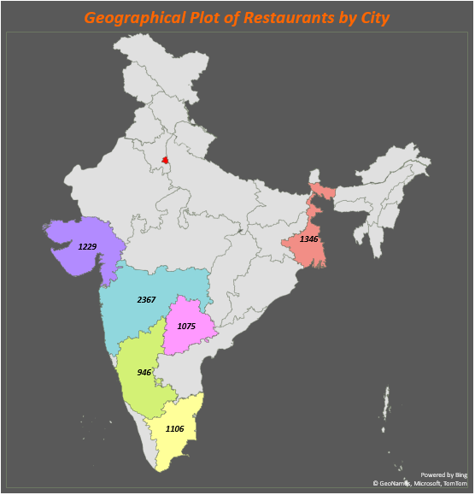
TASK 13: GEOGRAPHICAL MAPPING
Objective:
Geographical map showing restaurant locations in India.
City | State | Country | Sum of Count of Area
Delhi | New Delhi | India | 611
Bangalore | Karnataka | India | 946
Hyderabad | Telangana | India | 1075
Chennai | Tamilnadu | India | 1106
Ahmedabad, Surat | Gujarat | India | 1229
Kolkata | West Bengal | India | 1346
Mumbai, Pune | Maharashtra | India | 2367
Delhi
611
Ahmedabad & Surat
Kolkata
Mumbai & Pune
Hyderabad
Bangalore
New Delhi 611 Karnataka 946 Telangana 1075 Tamilnadu 1106 Gujarat 1229 West Bengal 1346 Maharashtra 2367
Chennai

Slide 31

RESTAURANTS PERFORMANCE BY CITY-WISE
Objective:
The table shows the performance of restaurants in each city is evaluated by examining the average rating, the number of restaurants, and the average delivery time.
Key Insights:
Delivery times in Ahmedabad and Surat are 45 and 48 minutes, respectively, faster than in other cities.
With 1075 restaurants, Hyderabad boasts a balanced delivery time of 50 minutes. Its 3.7 average rating indicates a high degree of client satisfaction.
With ratings between 3.5 and 3.6, Delhi and Mumbai consistently deliver within 51 and 48 minutes.
Additionally, Bangalore and Chennai have similar ratings (3.8) with delivery durations of roughly 51 and 59 minutes, respectively.
With 1346 restaurants, Kolkata has the most restaurants and the longest average delivery time (68 minutes).
City | Restaurant Count | Average of Ratings | Average Delivery Time in Mins
Ahmedabad | 717 | 3.6 | 45 Mins
Bangalore | 946 | 3.8 | 51 Mins
Chennai | 1106 | 3.8 | 59 Mins
Delhi | 611 | 3.5 | 51 Mins
Hyderabad | 1075 | 3.7 | 50 Mins
Kolkata | 1346 | 3.7 | 68 Mins
Mumbai | 1277 | 3.6 | 48 Mins
Pune | 1090 | 3.6 | 56 Mins
Surat | 512 | 3.6 | 48 Mins

Slide 32






TASK 14: BUSINESS RECOMMENDATIONS
Recommendations aim to improve efficiency, and customer satisfaction, and expand market reach based on city-specific data insights.
Improve Delivery Efficiency:
The longest average delivery time (68 minutes) is found in cities like Kolkata. To cut down on delivery times and boost customer satisfaction, concentrate on streamlining delivery processes through improved logistics and technology integration.
Target High-Rating Cities:
Bangalore and Chennai have lengthier delivery times (59 and 51 minutes) however, they have good ratings (3.8). Put methods in place to maintain high customer satisfaction levels while streamlining delivery.
Enhance Restaurant Count:
There are comparatively fewer eateries in cities like Ahmedabad and Surat (717 and 512, respectively), suggesting room for growth. Expand restaurant collaborations to satisfy the rising demand from patrons.
Address Region-Specific Preferences:
Kolkata is notable for having a longer delivery time (68 minutes) and a lower rating (3.7). To satisfy customer expectations, concentrate on improving food quality and streamlining delivery logistics.
Maintain Consistent Quality:
Cities with intermediate delivery times and consistent scores (3.6 to 3.7) include Delhi, Mumbai, and Hyderabad. To draw in and keep clients, concentrate on ensuring that all services are of the same caliber.
Utilize Customer Feedback:
Cities like Ahmedabad, Mumbai, and Pune, which have middling scores (around 3.6), should carefully examine consumer comments to identify areas where food quality, service, or delivery could be improved.

Slide 33


